Slide 1
Finding the Subnet, Broadcast and Useable Host Ranges
Lecture 11
Topic: Transport layer protocols: Process to process delivery, addressing
connectionless versus connection-oriented service, Three-way handshake protocol

Slide 2
Introduction
The data link layer is responsible for delivery of frames between two neighbouring nodes over a link. This is called node-to-node delivery.
The network layer is responsible for delivery of datagrams between two hosts. This is called host to-host delivery.
Communication on the Internet is not defined as the exchange of data between two nodes or between two hosts. Real communication takes place between two processes (application programs). We need process-to-process delivery.

Slide 3
Cont.
However, at any moment, several processes may be running on the source host and several on the destination host. To complete the delivery, we need a mechanism to deliver data from one of these processes running on the source host to the corresponding process running on the destination host.
The transport layer is responsible for process-to-process delivery-the delivery of a packet, part of a message, from one process to another.
Two processes communicate in a client/server relationship.

Slide 4

Cont.

Slide 5
Client-Sever Paradigm
Although there are several ways to achieve process-to-process communication, the most common one is through the client/server paradigm.
A process on the local host, called a client, needs services from a process usually on the remote host, called a server.
Both processes (client and server) have the same name. For example, to get the day and time from a remote machine, we need a Daytime client process running on the local host and a Daytime server process running on a remote machine.

Slide 6
Cont.
IF we need to deliver something to one specific destination among many, we need an address.
At the data link layer, we need a MAC address to choose one node among several nodes if the connection is not point-to-point.
At the network layer, we need an IP address to choose one host among millions.

Slide 7
Cont.
At the transport layer, we need a transport layer address, called a port number, to choose among multiple processes running on the destination host. The destination port number is needed for delivery; the source port number is needed for the reply.
In the Internet model, the port numbers are any integers between 0 and 65,535. The client program defines itself with a port number, chosen randomly by the transport layer software running on the client host. This is the ephemeral port number.

Slide 8
Cont.
The server process must also define itself with a port number. This port number, however, cannot be chosen randomly.
The Internet has decided to use universal port numbers for servers; these are called well-known port numbers.
Every client process knows the well-known port number of the corresponding server process. For example, while the Daytime client process, can use an ephemeral (temporary) port number 52,000 to identify itself, the Daytime server process must use the well-known (permanent) port number 13.

Slide 9

Cont.

Slide 10

Cont.
It should be clear by now that the IP addresses and port numbers play different roles in selecting the final destination of data. The destination IP address defines the host among the different hosts in the world. After the host has been selected, the port number defines one of the processes on this particular host.

Slide 11
Socket address
Process-to-process delivery needs two identifiers, IP address and the port number, at each end to make a connection.
The combination of an IP address and a port number is called a socket address. The client socket address defines the client process uniquely just as the server socket address defines the server process uniquely.
A transport layer protocol needs a pair of socket addresses: the client socket address and the server socket address.

Slide 12
Socket address
These four pieces of information are part of the IP header and the transport layer protocol header. The IP header contains the IP addresses.
UDP or TCP header contains the port numbers.

Slide 13

Socket address

Slide 14
Connectionless Versus Connection-Oriented Service
Connectionless Service
In a connectionless service, the packets are sent from one party to another with no need for connection establishment or connection release.
The packets are not numbered; they may be delayed or lost or may arrive out of sequence.
There is no acknowledgment either. We will see shortly that one of the transport layer protocols in the Internet model, UDP, is connectionless.

Slide 15
Cont.
Connection-Oriented Service
In a connection-oriented service, a connection is first established between the sender and the receiver. Data are transferred. At the end, the connection is released.

Slide 16
Reliable Versus Unreliable
The transport layer service can be reliable or unreliable.
If the application layer program needs reliability, we use a reliable transport layer protocol by implementing flow and error control at the transport layer. This means a slower and more complex service.
On the other hand, if the application program does not need reliability because it needs fast service or the nature of the service does not demand flow and error control (real-time applications), then an unreliable protocol can be used.

Slide 17
Cont.
In the Internet, there are three common different transport layer protocols.
UDP is connectionless and unreliable.
TCP and SCTP (Stream Transmission Control Protocol) are connection oriented and reliable. These three can respond to the demands of the application layer programs.

Slide 18
Question
If the data link layer is reliable and has flow and error control, why do we need this at the transport layer, too?
Answer
Reliability at the data link layer is between two nodes; we need reliability between two ends. Because the network layer in the Internet is unreliable (best-effort delivery), we need to implement reliability at the transport layer. To understand that error control at the data link layer does not guarantee error control at the transport layer.

Slide 19
TCP Services
Services offered by TCP :
Process-to-process Communication
Stream Delivery Service
Full-Duplex Communication
Connection-Oriented Service (TCP)
Reliable Service

Slide 20
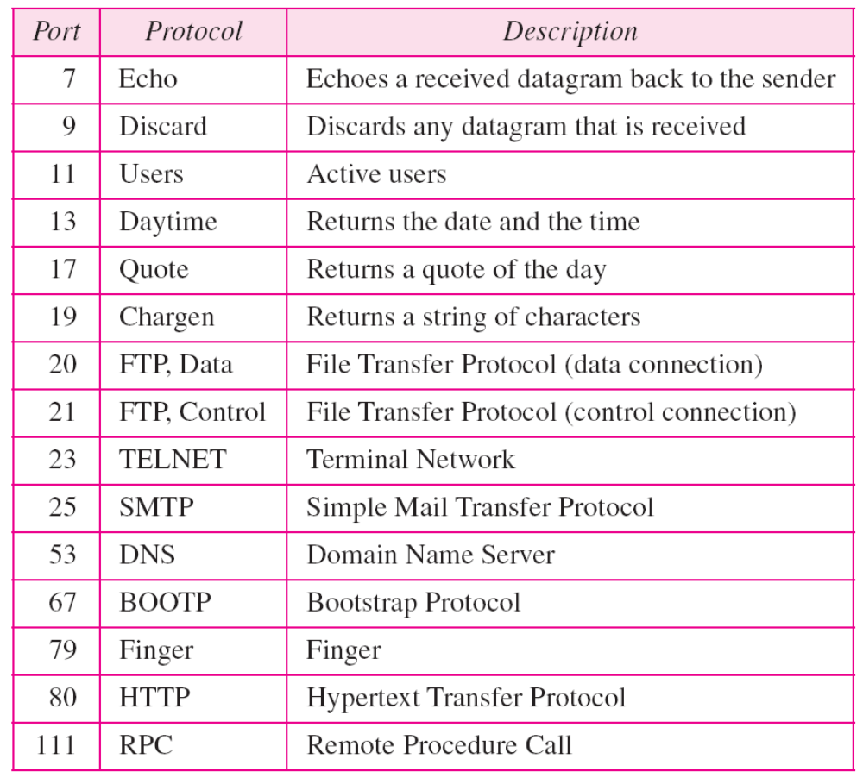
Well-known ports used by TCP

Slide 21

Example:
Suppose a TCP connection is transferring a file of 5000 bytes. The first byte is numbered 10,00l. What are the sequence numbers for each segment if data are sent in five segments, each carrying 1000 bytes?
Solution
The following shows the sequence number for each segment:
The value in the sequence number field of a segment defines the number of the first data byte contained in that segment. The value of the acknowledgment field in a segment defines the number of the next byte a party expects to receive. The acknowledgment number is cumulative.

Slide 22

FORMAT OF TCP SEGMENT
HLEN : Header Length

Slide 23
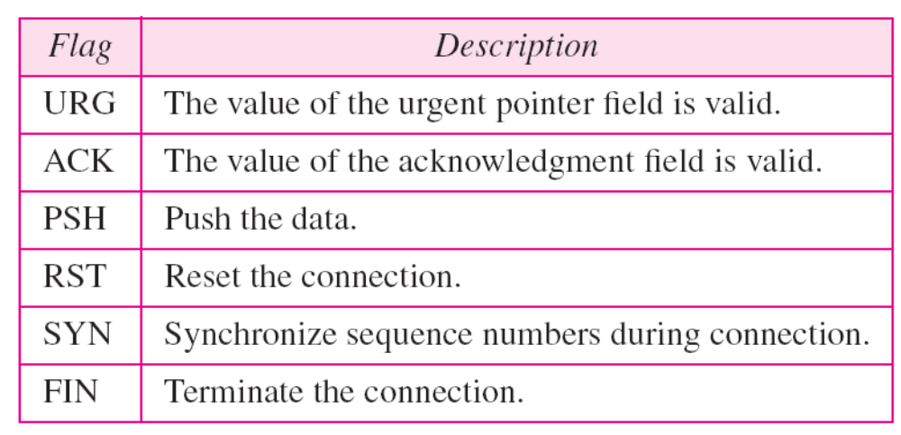
Control Field

Slide 24
TCP CONNECTION
TCP is connection-oriented. A connection-oriented transport protocol establishes a virtual path between the source and destination. All the segments belonging to a message are then sent over this virtual path. Using a single virtual pathway for the entire message facilitates the acknowledgment process as well as retransmission of damaged or lost frames.

Slide 25
TCP CONNECTION
TCP uses the services of IP to deliver individual segments to the receiver, but it controls the connection itself. If a segment is lost or corrupted, it is retransmitted.
In TCP, connection-oriented transmission requires three phases:
i. Connection establishment
ii. Data transfer
iii. Connection termination

Slide 26
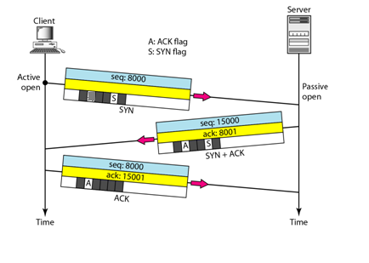
Connection establishment using three-way handshaking
The client sends the first segment, a SYN segment, in which only the SYN flag is set. This segment is for synchronization of sequence numbers. It consumes one sequence number. When the data transfer starts, the sequence number is incremented by 1.

Slide 27
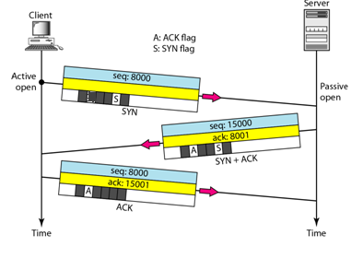
Cont.
The server sends the second segment, a SYN + ACK segment, with 2 flag bits set: SYN and ACK. This segment has a dual purpose. It is a SYN segment for communication in the other direction and serves as the acknowledgment for the SYN segment. It consumes one sequence number.

Slide 28
Cont.
The client sends the third segment. This is just an ACK segment. It acknowledges the receipt of the second segment with the ACK flag and acknowledgment number field. Note that the sequence number in this segment is the same as the one in the SYN segment.

